Slide 1
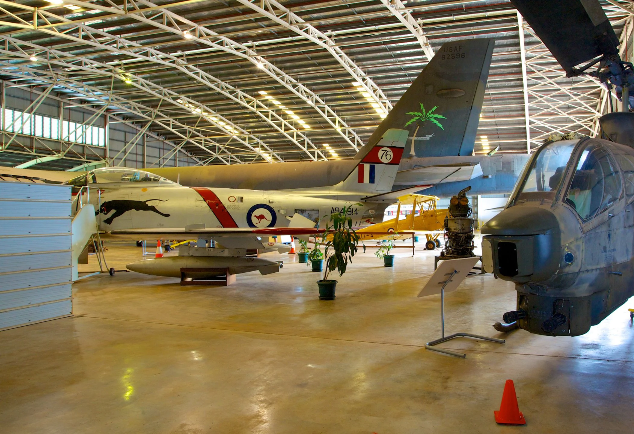
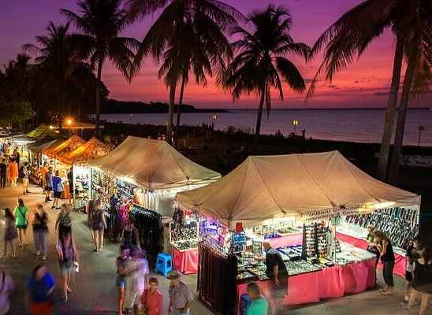

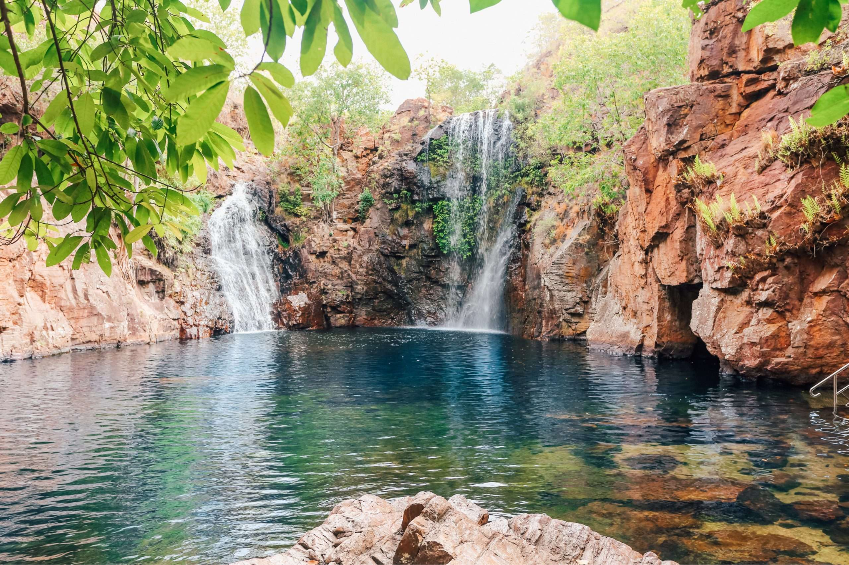
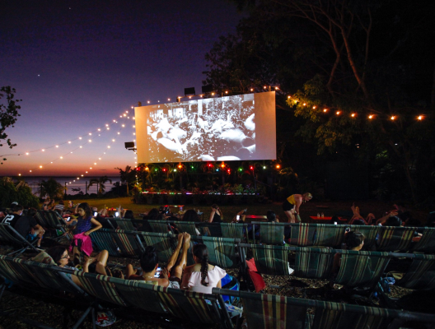
Simbarashe Mutyambizi: s385833.
Syed Haroon Ahmad: s393516
Mehraab Ferdouse: s393148
Saugat Poudel: s395696
IT CODEFAIR 2025 DATA SCIENCE CHALLENGE
Group DSC005

Slide 2
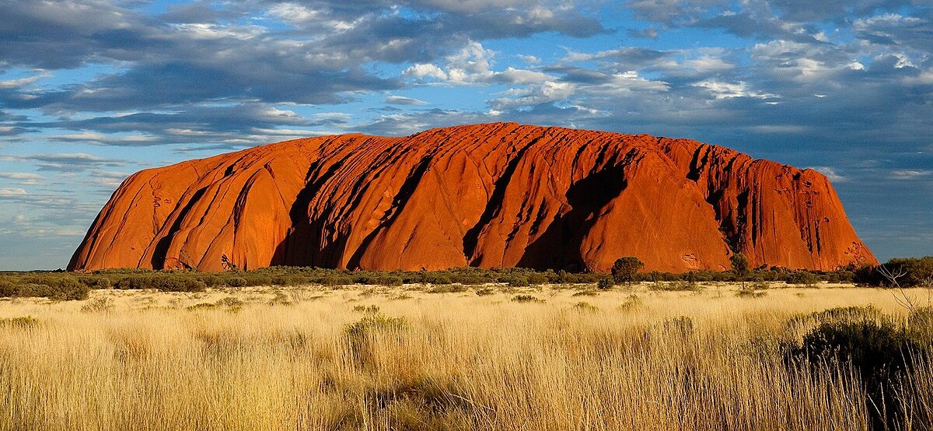
"CDU acknowledges the traditional custodians of the lands on which we live, learn, work, and play. We pay our respects to the Larrakia people, the traditional custodians of this land”
Acknowledgement

Slide 3
Approach
Darwin is a melting pot of different cultures and tourist attraction points, and we want to incorporate this crucial element of Darwin into our analysis.
Hence we have broken down this investigation into four target categories:
Museums
National parks
Markets and cultural attractions
Cruises

Slide 4
Cultural Tourism (markets & cinema)
Data in relation to the markets consisted of the following:
Parap Market.
Tiwi Islands.
Nightcliff Markets.
Pudakul Aboriginal cultural tours.
Tourists enjoyed the food and craft stalls around the markets, especially highlighting on how close they are to each other, allowing them to window shop as they wait for their food. One of the most recommended stalls was “Mary Laksa”, located at Parap market, as it was praised for its delicious Laksa dish.
In addition to that we analyzed the Deckchair cinema, which consisted of positive reviews.
Notes:
however customers have complained about the comfortability of the chairs, some stating that they often break, in addition to the insects that crawl around.

Slide 5
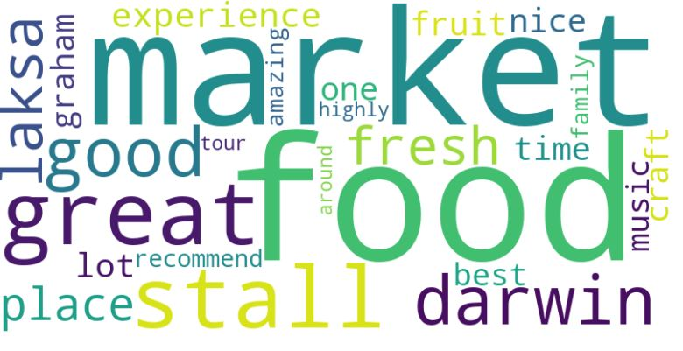
Word cloud for Markets

Slide 6
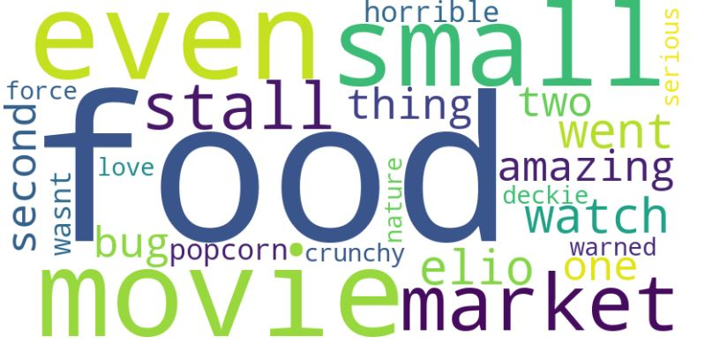
Negative word cloud for markets and cinema

Slide 7
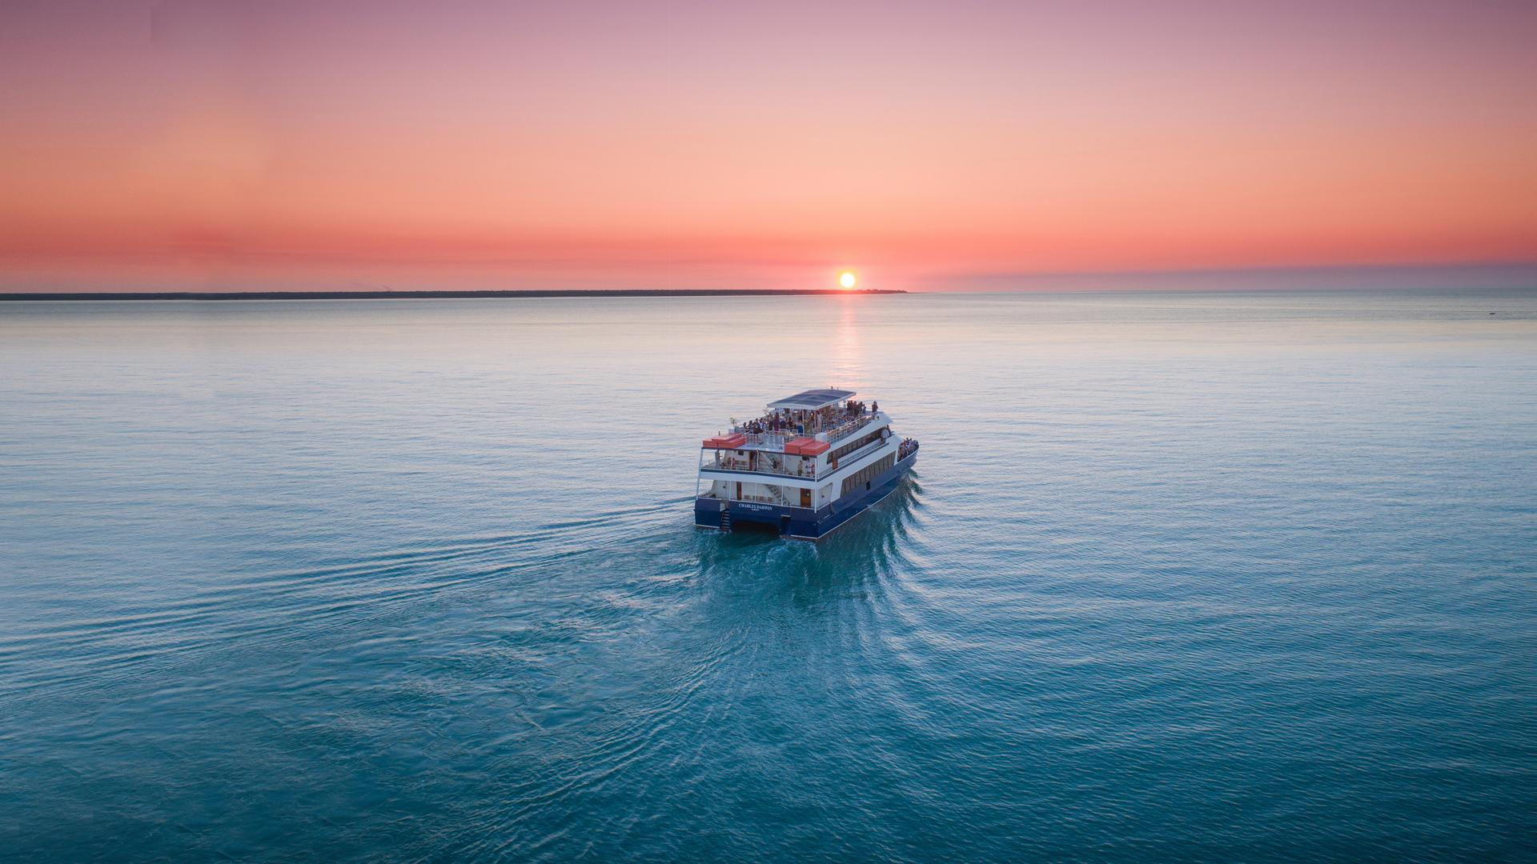
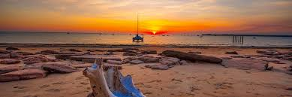
Cruises
Reviews were collected from Darwin Harbour sunset and sightseeing cruises and more via Google Maps covering overall experience, service, food, and scenery.
Sentiment Summary:
🟢 Positive: 895 ⚪ Neutral: 46 🔴 Negative: 58
Overall sentiment was strongly positive, with travellers praising the friendly crew, spectacular sunset views, and relaxing onboard atmosphere.
Minor concerns related to food variety, pricing, and weather comfort, but cruises remain one of Darwin’s most memorable and well-rated tourist experiences.

Slide 8
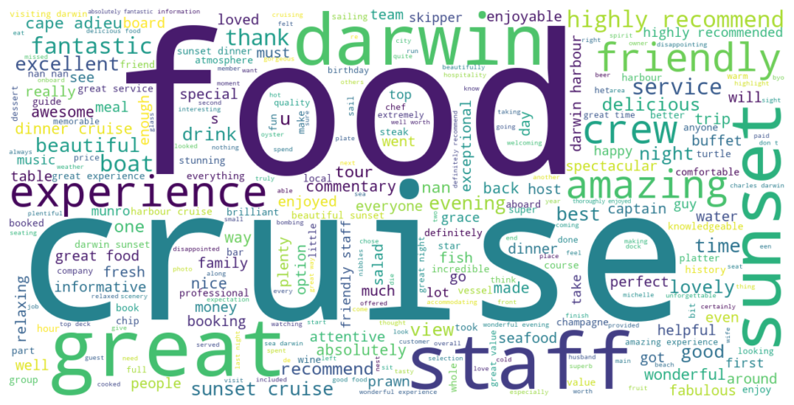
Word cloud for cruises

Slide 9
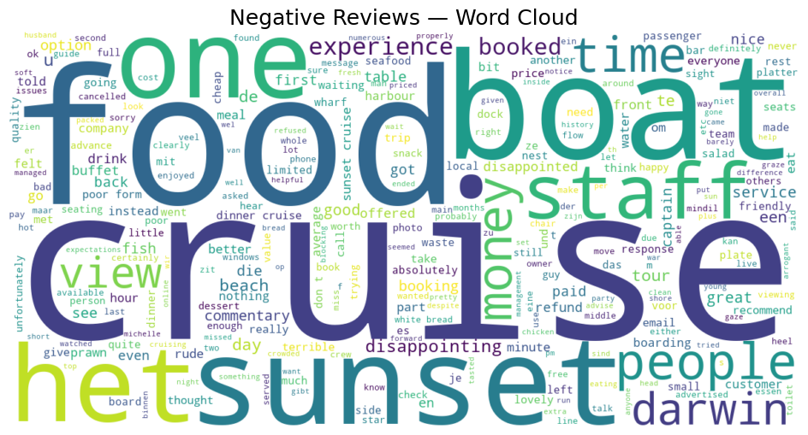
Negative word cloud for cruises

Slide 10
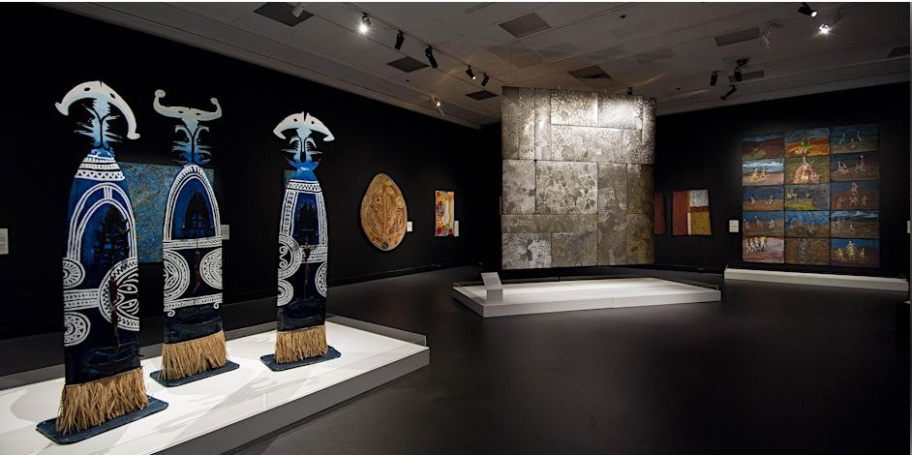
Museums
Our museums dataset consisted of reviews from:
Darwin Military museum.
Museum and ARt Gallery of the Northern Territory.
Royal Flying Doctor tourist facility.
Darwin Aviation Museum.
Darwin Military Museum.
The overall sentiment for museums reflected enjoyment of the exhibitions, especially towards the Aboriginal art pieces from the Museum and art gallery of the Northern Territory. Another interesting reflection from tourists is in relation to the tragic Cyclone Tracy that devastated Darwin in 1974, as tourists are astounded about the resilience of the people of Darwin, to bounce back from such a devastating disaster.
Notes:
One human aspect that stood out from the reviews was the appreciation for the fun and caring customer service provided by the staff of these museums. This points out that wonderful customer service in this domain of tourism does improve overall sentiment and will lead to more recommendations and traction.

Slide 11
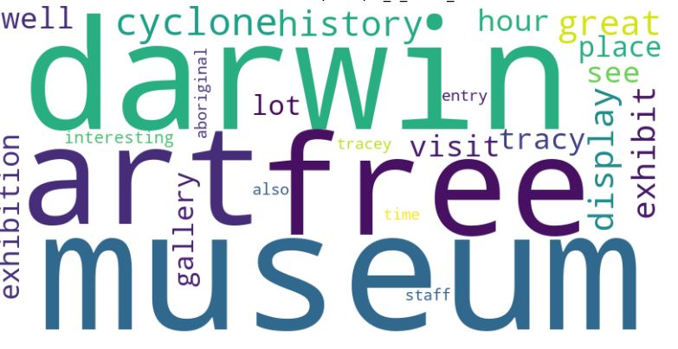
Word cloud for Museum

Slide 12
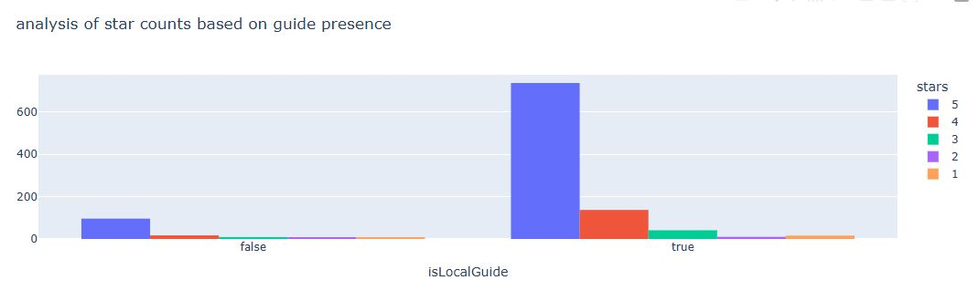
Data about local guides influencing reviews
Notes:
The presence of a local guide influence the length of the overall review text, with the average review text tourist attractions with guides being 34 and those without being 28. This is also backed by a two sample t test and by the distribution of stars based on local guide presence. 88% of the 5 star reviews went to attractions with guides. Even though there aren't any museums or national parks that don't provide local guides in general, some tourist attractions like Outstation Gallery, Pudakul Aboriginal Cultural Tours and Kakadu National Park would see increased positive 5 stars counts and 3,4 stars as well.

Slide 13
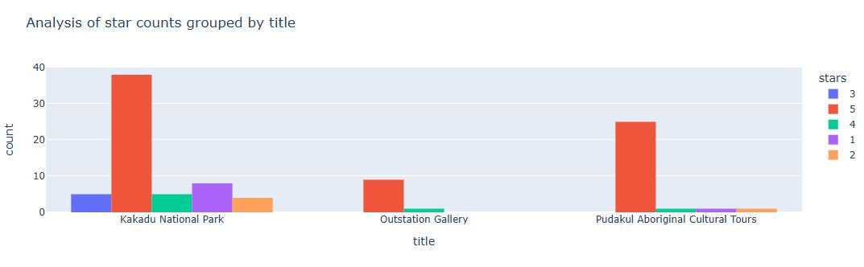
Data about no. of tour guides

Slide 14
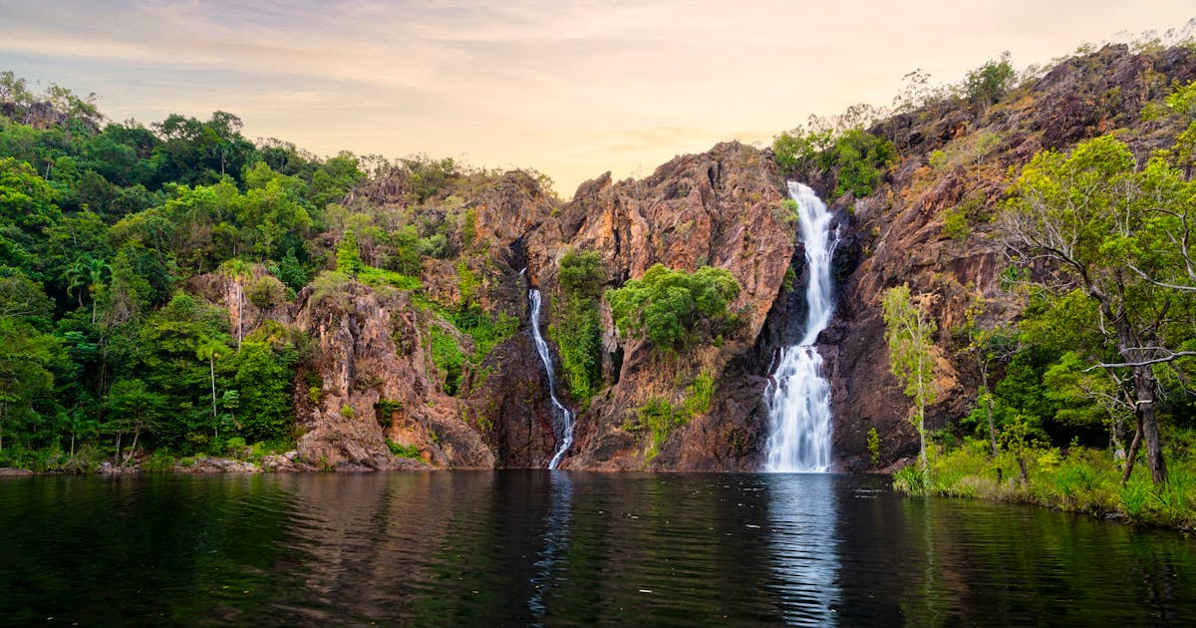
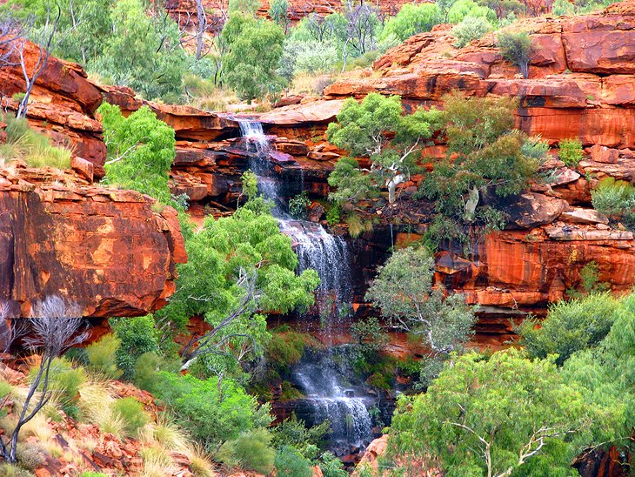
National Parks
The dataset consisted of review data from the following national parks:
Litchfield National Park.
Nitmiluk National Park.
Uluru Kata Tjuta.
Watarrka National Park.
Charles Darwin University National Park.
Tourists enjoyed the national parks especially those that had walking trails, enabling them to safely wander in the parks and observe the beautiful nature, and especially those that have facilities like restaurants, toilets and are also close to the city (Charles Darwin University and Nitmiluk National Parks).
Notes:
However, tourists complain about the insects and recommend others to carry insect repellent if they were to visit these parks. Hence we recommend these national parks provide this utility to tourists (if they don’t do so already) as it will inevitably lead to better enjoyment of the tour. This is evident in the reviews of the “Gorge” attraction point of Nitmiluk National Park, as tourists state that they love the Gorge, but absolutely hate the bugs that crawl onto them.

Slide 15
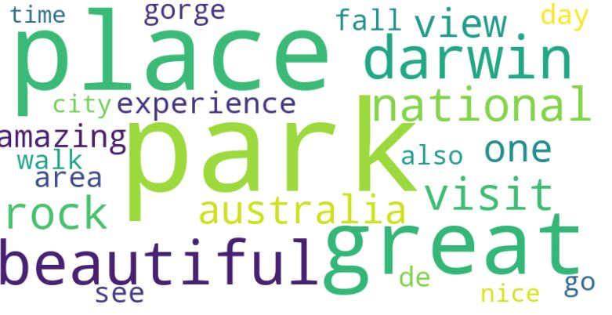
Word cloud for National Parks

Slide 16
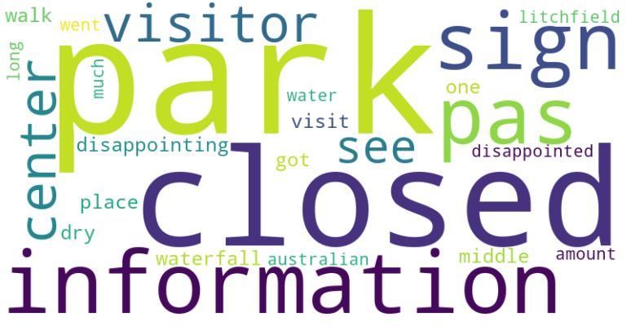
Word cloud of negative reviews about National Parks

Slide 17
If you have any questions,
You may ask them now

